Slide 1
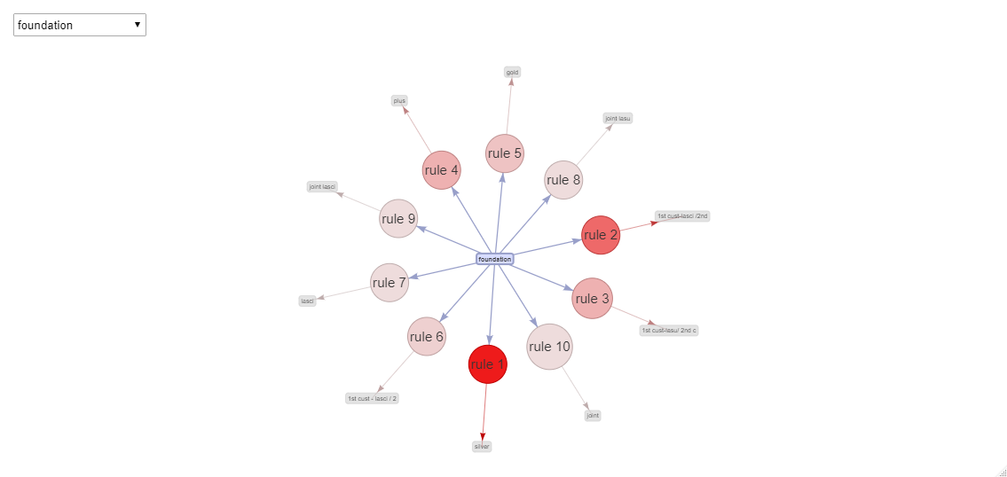
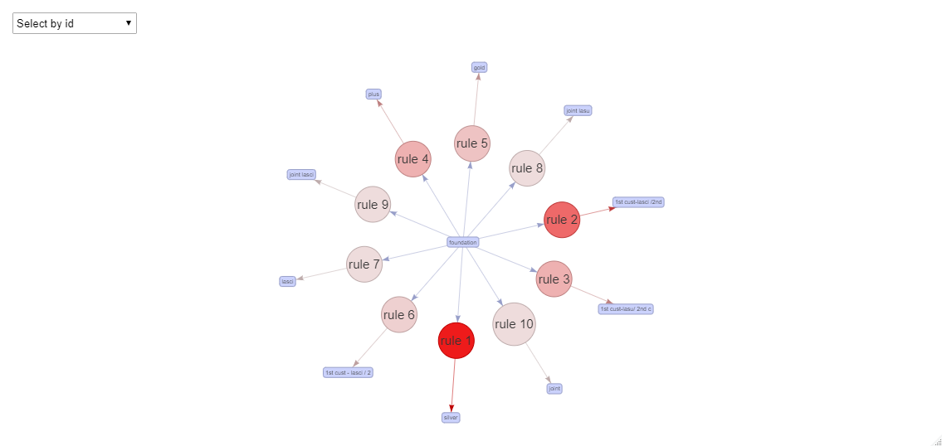
Assumptions Approach
The goal of the business problem is to identify the target from the pool of customers that currently do not have a PPI and the type of PPI product they should be targeting with.
Since the dataset is unique at each level, and there are no repeated purchase of products , hence Mosaic class (i.e Customer Segment) and products purchased each Mosaic class are being considered.
For analysis, the required columns that are being considered are:
'Mosaic','Mosaic_Class','Insurance_Description','category','prdt_desc','Credit_Score','Loan_Type','Income_Range’.
Next, filtered data with PPI=1 was considered and according to that the data frame was being filtered.
Apriori Algorithm was implemented with aggregated Insurance Description and Mosaic class and being saved as transactions.
Next, rules are created from Apriori algorithm with minimum confidence as 0.25 and support = 0.006.
Next, rules are sorted according to decreasing confidence.
With the redundant rules, removed, the modified rules are saved and the top10 rules as per by confidence are saved as graph.
The relationship with respect to rules are added in graph . Attached are the rules which shows the targeted customers and the type of PPI product along with the code and the final output.

